Slide 1
Welcome
Pension Update Community Meeting April 5, 2018

Slide 2
Why Are We Here?
Discuss CalPERS
Rising CalPERS Retirement Costs
Severe Negative Financial Impact to the City

Slide 3
Why Are We Here?
What is CalPERS?
How Do CalPERS Pensions Work?
Is there Enough Funding?
Why are Retirement Costs Increasing?
What is the Financial Impact to the City of West Covina?
What is the Impact on City of West Covina Residents and Employees?

Slide 4
Why Are We Here?
What is CalPERS?
How Do CalPERS Pensions Work?
Is there Enough Funding?
Why are Retirement Costs Increasing?
What is the Financial Impact to the City of West Covina?
What is the Impact on City of West Covina Residents and Employees?

Slide 5
What is CalPERS?
California Public Employees’ Retirement System
Nation’s largest pension fund
Established in 1932
Defined Benefit System
Vested Employee (minimum 5 years of service) entitled to collect a monthly payment for life based on a formula
Employers include
State Agencies
Schools
Local Public Agencies
1.9M Members

Slide 6
What is CalPERS?
Employers
Members
State of
CA
1
State of CA
604,556
31%
School Districts
1,366
School Districts 726,029
38%
2,945
1.9M
Public Agencies 1,581
Public Agencies 594,874
31%

Slide 7



What is CalPERS?
All 2,000+ employers’ money is pooled together and invested
Pooled investments are called the Public Employee Retirement Fund (PERF)
Each employer has their own independent pool with their own “funded level”
West Covina
Miscellaneous
Safety

Slide 8
Why Are We Here?
What is CalPERS?
How Do CalPERS Pensions Work?
Is there Enough Funding?
Why are Retirement Costs Increasing?
What is the Financial Impact to the City of West Covina?
What is the Impact on City of West Covina Residents and Employees?
8

Slide 9
How do CalPERS Pensions Work?
3 Legged Stool
(Shared Responsibility)
PENSION
Employer Contribution
CalPERS
Employee Contribution
Investment Earnings
Discount Rate

Slide 10
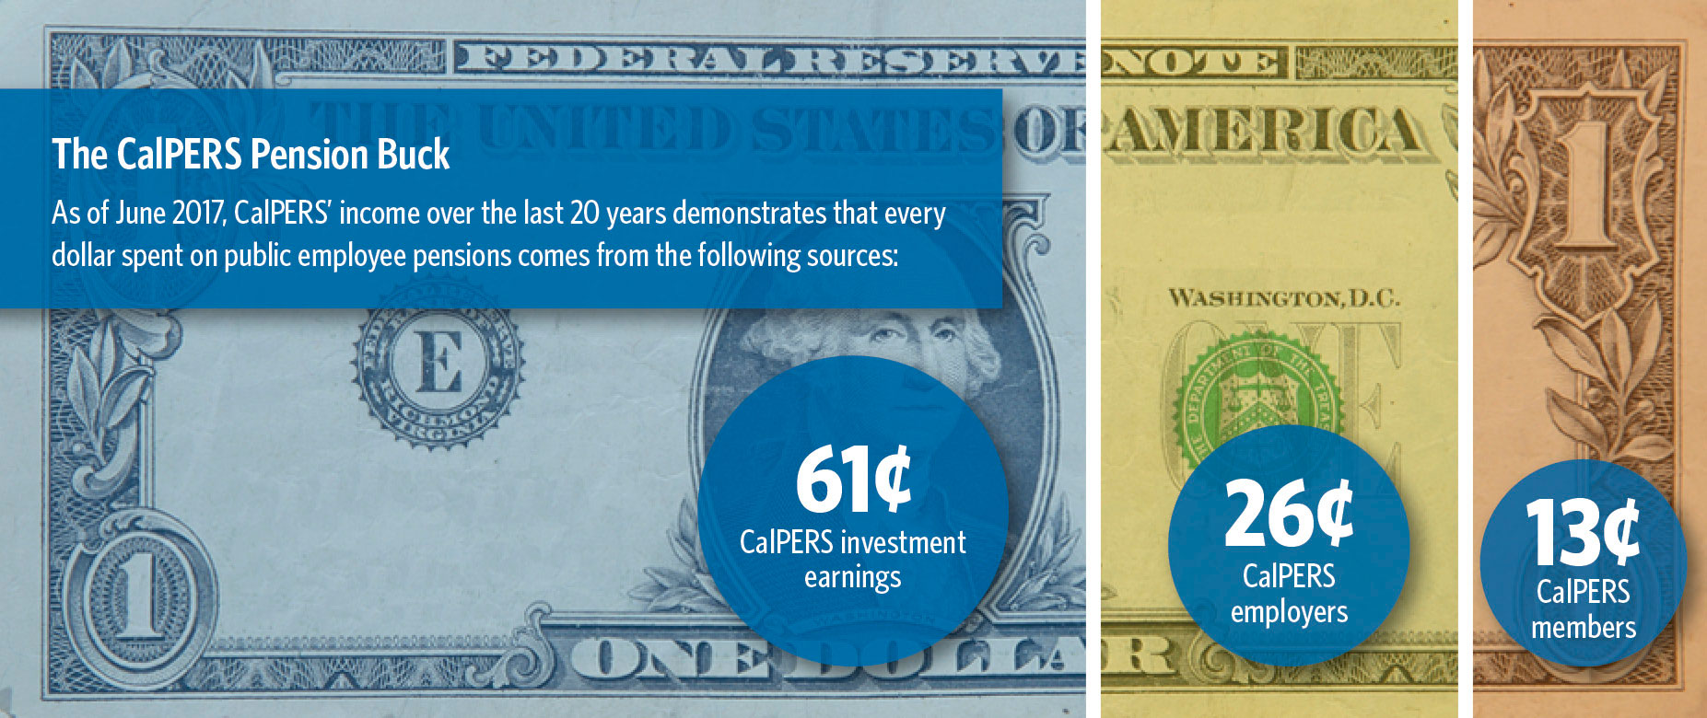
How do CalPERS Pensions Work

Slide 11
How do CalPERS Pensions Work?
Miscellaneous Employee Formulas
2.5% @ 55 2% @ 60 2% @ 62
Public Safety Formulas
3% @ 50 3% @ 55 2.7% @ 57
Simple Retirement Calculation
Years of Service X Formula Percentage X Salary = Retirement Salary
Factors that Impact Retirement
Age at Retirement
Single Highest Year vs. Highest Years of Salary
Incentive Pays
Number of Pension Formulas

Slide 12
How do CalPERS Pensions Work?
Sample Retirement Calculation:
Years of Service X Formula Percentage X Salary = Retirement Salary
30 years X 2% X $60,000 = $36,000/year

Slide 13
Why Are We Here?
What is CalPERS?
How Do CalPERS Pensions Work?
Is there Enough Funding?
Why are Retirement Costs Increasing?
What is the Financial Impact to the City of West Covina?
What is the Impact on City of West Covina Residents and Employees?
13

Slide 14
Is there Enough Funding?
100% Goal
68% Current
50% Danger zone
As of July 2017, CalPERS is only 68% funded.
Means there is only 68 cents for every dollar needed to fund retiree benefits
CalPERS goal is to be 100% funded.
Experts warn that the system may no longer be viable if the funding level drops below 50-55% funded.

Slide 15
City of West Covina Funding
Miscellaneous
Public Safety
100% Goal
71.4% Current
50% Danger zone
100% Goal
61.8% Current
UAL
28.6%
UAL
38.2%
50% Danger zone

Slide 16
3 Legged Stool
(Shared Responsibility)
PENSION
Employer Contribution
CalPERS
Employee Contribution
Investment Earnings
Discount Rate

Slide 17
City of West Covina
Pension (748 Retirees)
$27M
<$13.1M>
UAL
City Contributions
CalPERS
Investment Earnings
Employee Contributions
$10.3M
$2.3M
$1.3M
319 members

Slide 18
City of West Covina
FY 16-17 FY 24-25
Miscellaneous Employee 25.8% 45.5%
Safety Employee 53.7% 79.2%
Total Employer Contribution Payments

Slide 19
Why Are We Here?
What is CalPERS?
How Do CalPERS Pensions Work?
Is there Enough Funding?
Why are Retirement Costs Increasing?
What is the Financial Impact to the City of West Covina?
What is the Impact on City of West Covina Residents and Employees?
19

Slide 20
Why are Retirement Costs Increasing?
Primary Reason – economic downtown in 2008 when CalPERS suffered a 27% negative return. Resulted in a gross impact of 34.75% loss to the fund.
CalPERS Rate of Return Being Dropped from 7.5% to 7% in the next 3 years
2017-18 – 7.5%
2018-19 – 7.375%
2019-20 – 7.25%
2020-21 – 7%

Slide 22
Why are Retirement Costs Increasing?
Other Factors:
Unfunded Accrued Liability (UAL) Increases
CalPERS looking to reduce expected returns even more so (6%)
Last 10 Years – Investment Returns of 5.0%

Slide 23
Why Are We Here?
What is CalPERS?
How Do CalPERS Pensions Work?
Is there Enough Funding?
Why are Retirement Costs Increasing?
What is the Financial Impact to the City of West Covina?
What is the Impact on City of West Covina Residents and Employees?
23

Slide 24
What is the Financial Impact to the City of West Covina?
MISCELLANEOUS -7 Year Outlook
TOTAL INCREASE $3.4M
Normal Cost Contribution Rate 7.9% expected to be 9.4% increase of $433K
Unfunded Liability Payment expected increase of $3M
FY 17-18 |  | FY 18-19 |  | FY 19-20 |  | FY 20-21 |  | FY 21-22 |  | FY 22-23 |  | FY 23-24 |  | FY 24-25
$845K |  | $909K |  | $985K |  | $1.1M |  | $1.2M |  | $1.2M |  | $1.2M |  | $1.3M
FY 17-18 |  | FY 18-19 |  | FY 19-20 |  | FY 20-21 |  | FY 21-22 |  | FY 22-23 |  | FY 23-24 |  | FY 24-25
$1.9M |  | $2.4M |  | $3.0M |  | $3.4M |  | $4.0M |  | $4.4M |  | $4.7M |  | $4.9M

Slide 25
What is the Financial Impact to the City of West Covina?
SAFETY -7 Year Outlook
TOTAL INCREASE $8.5M
Normal Cost Contribution Rate 19.2% expected to be 22.1% increase of $1.4M
Unfunded Liability Payment expected increase of $7.1M
FY 17-18 |  | FY 18-19 |  | FY 19-20 |  | FY 20-21 |  | FY 21-22 |  | FY 22-23 |  | FY 23-24 |  | FY 24-25
$3.8M |  | 3.9M |  | $4.3M |  | $4.8M |  | $4.9M |  | $5.1M |  | $5.2M |  | $5.4M
FY 17-18 |  | FY 18-19 |  | FY 19-20 |  | FY 20-21 |  | FY 21-22 |  | FY 22-23 |  | FY 23-24 |  | FY 24-25
$6.9M |  | $7.9M |  | $9.2M |  | $10.1M |  | $11.4M |  | $12.5M |  | $13.3M |  | $13.9M

Slide 26
What is the Financial Impact to the City of West Covina? Retirement Cost Recap – 7 Year Outlook
 | FY 17-18 |  | FY 24-25 |  | Increase
Normal Cost | $ 4,672,248 |  | $ 6,498,658 |  | $ 1,826,410
UAL | $ 8,790,662 |  | $ 18,840,000 |  | $ 10,049,338
TOTAL | $ 13,462,910 |  | $ 25,338,658
Total Increase |  | $11.9M

Slide 27
Why Are We Here?
What is CalPERS?
How Do CalPERS Pensions Work?
Is there Enough Funding?
Why are Retirement Costs Increasing?
What is the Financial Impact to the City of West Covina?
What is the Impact on City of West Covina Residents and Employees?
27

Slide 28
What is the Impact on the City of West Covina Residents and Employees?
Need to continue looking for new revenues (i.e taxes, fees, charges for services)
Need to continue looking at ways to reduce expenditures
Look for new partnerships
Look at benefit increases that do not increase pension liabilities
If we don’t?????
Reduction in staffing
Reduction in Employees Retirement Benefits
City/Employees Need to Pay the Difference
Reduction in services to residents and businesses

Slide 29
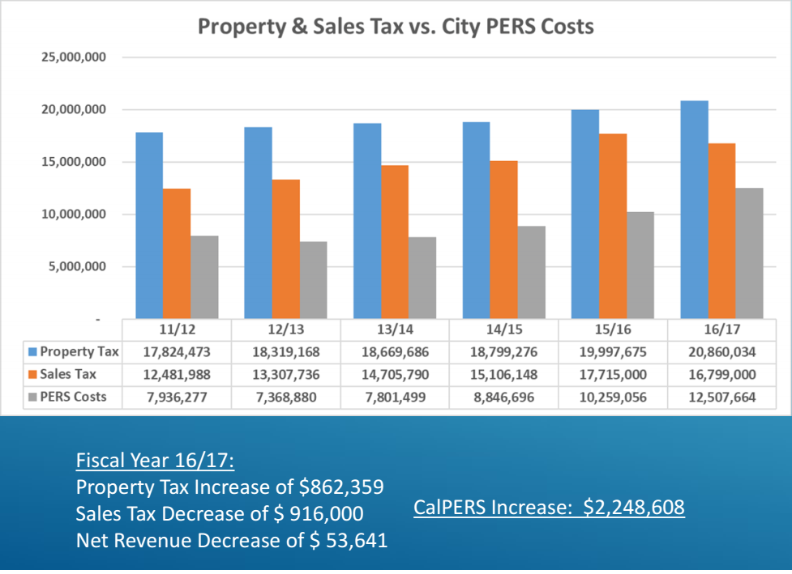

Slide 30
Future Challenges
Sales and Property Taxes are the City’s largest revenue source
Increases in Sales and Property Taxes is not covering Increases in pension obligations
What about costs increase for doing business?
Salary Increases
Contract Cost Increases
Utilities Cost Increases (fuel, electric, water)
UAL will not be paid off for at least 30 years
Retiree Medical UAL - $55.8 million ($1.9 Million/year)

Slide 31
CalPERS Actuarial Valuation Report is available on the City’s Website
http://www.westcovina.org/departments/finance/calpers-actuarials

Slide 32
Questions?

