Slide 1
City of West Covina 2021-2029 Housing Element
October 27, 2021
Town Hall Meeting

Slide 2

Overview
West Covina
General Plan
Our Natural Community
Our Prosperous Community
Our Well Planned Community
Our Accessible Community
Our Resilient Community
Our Healthy and Safe Community
Our Creative Community
Our Active Community

Slide 3
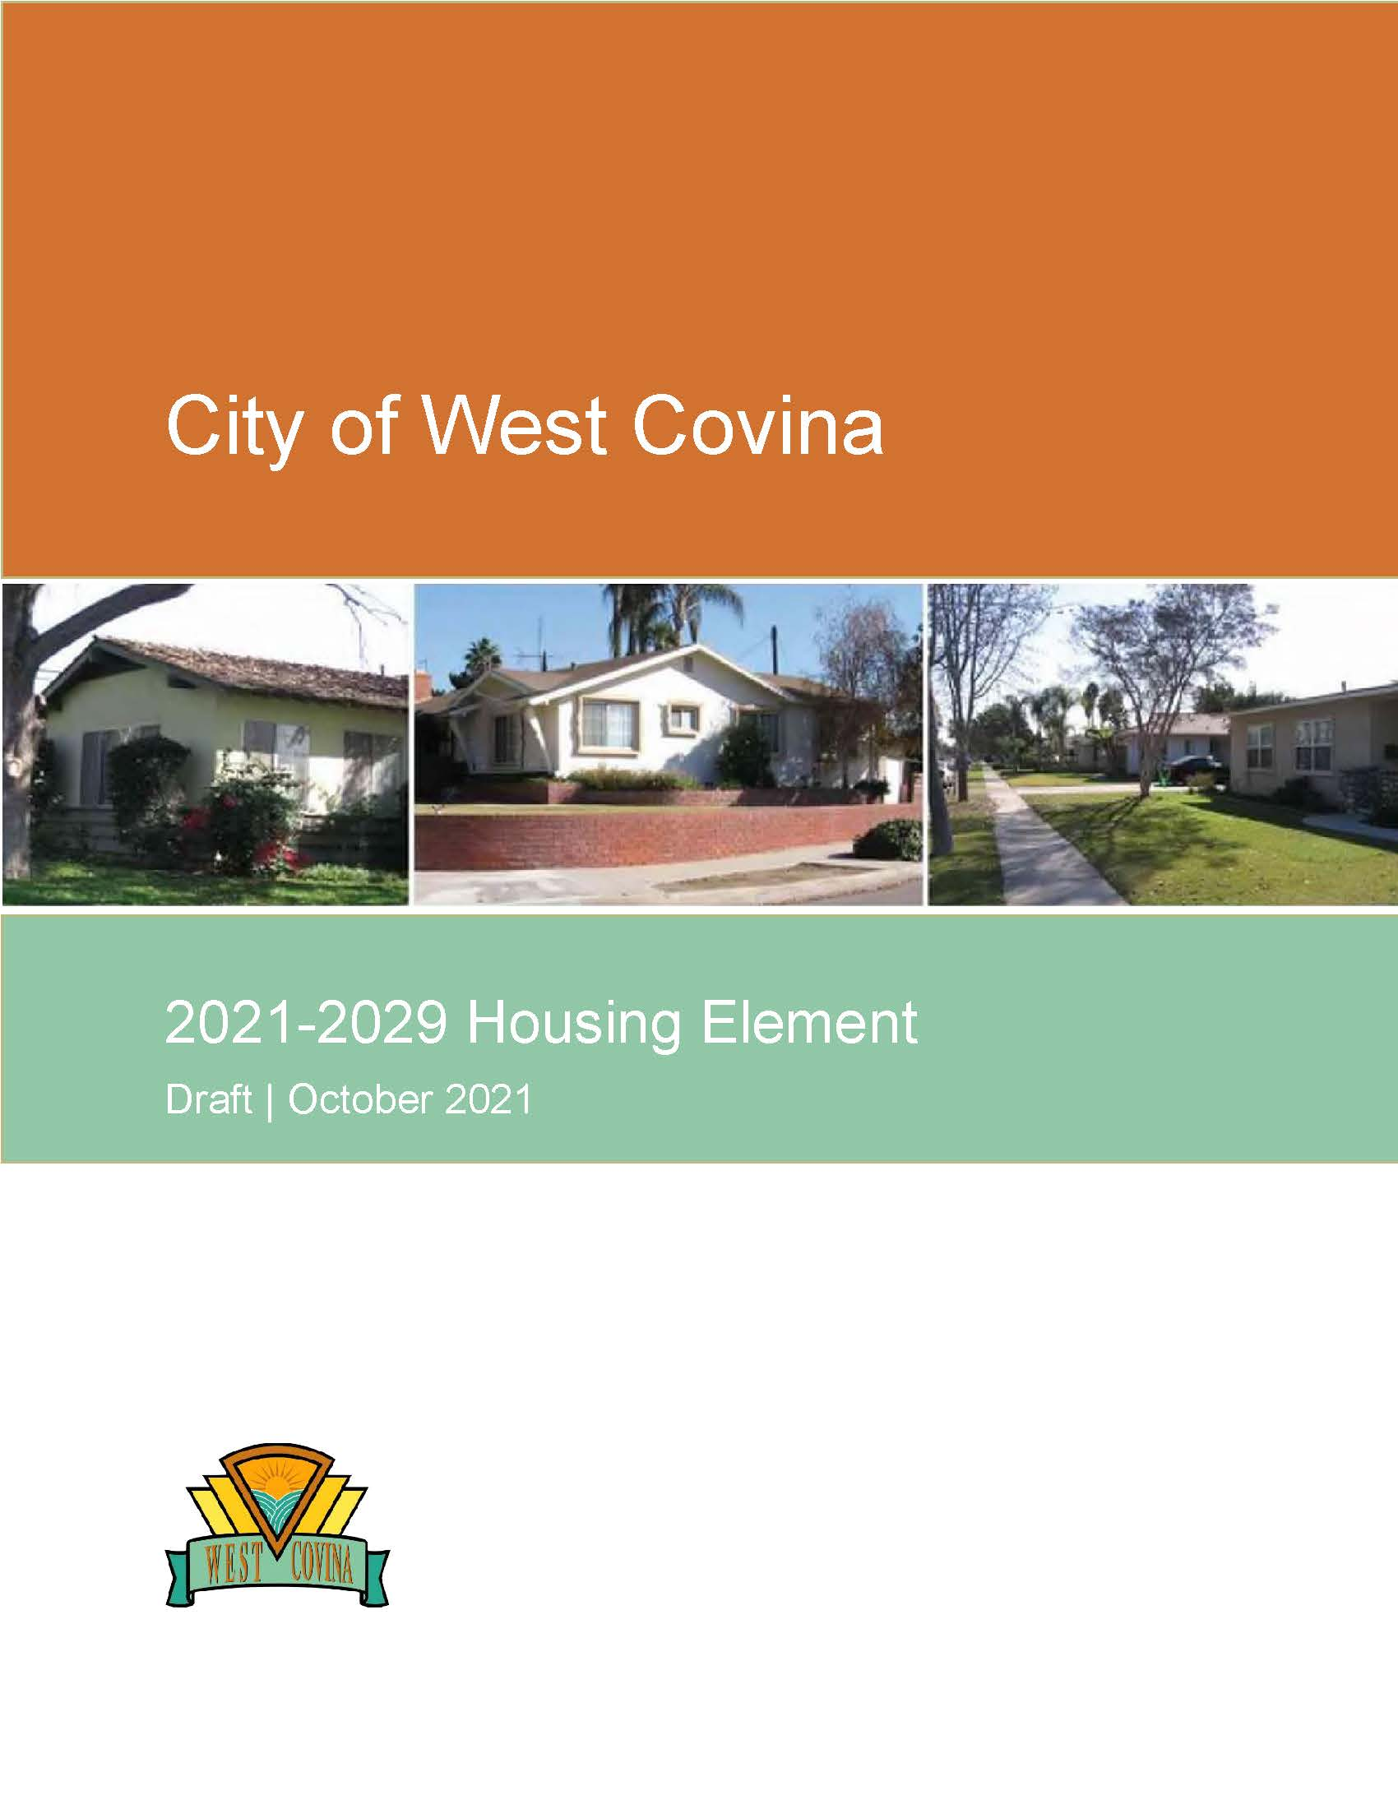
Overview
Housing Element is a required part of the General Plan
Housing Element updates required every 8 years
2021-2029 update (“6th cycle”)
State oversight & Housing Element “certification”

Slide 4
Overview
Housing is a “matter of statewide importance”
State Legislature has delegated HCD authority to review Housing Elements for compliance (“certification”)
Certification supports the legal validity of the Housing Element and General Plan

Slide 5
Housing Element Guiding Principles
Maintain & improve existing housing
Plan for regional growth needs for all economic segments & housing types
Minimize constraints to housing of all types
Affirmatively further fair housing

Slide 6
What is Affordable Housing?
LA County Median Income = $80,000 | Income Limits | Affordable Rent | Affordable Price (est.)
Extremely Low (<30%) | $35,450 | $886 | ---
Very Low (31-50%) | $59,100 | $1,478 | ---
Low (51-80%) | $94,600 | $2,365 | ---
Moderate (81-120%) | $96,000 | $2,400 | $425,000
Above Mod (>120%) | >$96,000 | >$2,400 | >$425,000
Assumptions: Based on a family of 4 30% of gross income for rent or PITI 10% down payment, 4% interest, 1.25% taxes & insurance, $300 HOA dues

Slide 7
Key Requirements
Housing for Persons with Special Needs
Regulations & procedures consistent with fair housing law
Regional Housing Needs Assessment (RHNA)
Adequate sites to accommodate assigned need

Slide 8
Special Needs
Persons with special needs
Elderly
Large families (5+)
Persons with disabilities
Homeless
Female-headed households
Farmworkers

Slide 9
Special Needs
Housing for persons with special needs
Affordable workforce housing
Transitional housing
Supportive housing
Emergency shelters & navigation centers
Residential care facilities
Reasonable accommodation

Slide 10
RHNA
Mandated by State law & prepared by SCAG
Each city must accommodate its assigned share of the region’s new housing need
Housing for all economic segments
Linked to available sites with appropriate zoning

Slide 11
RHNA
6th Planning Cycle (2021-2029)
SCAG region: 1,341,827 units
Los Angeles County: 812,060 units
West Covina: 5,346 units

Slide 12
RHNA
West Covina RHNA (2021-2029)
Income
Category Units
Very low 1,653
Low 850
Moderate 865
Above mod 1,978
Total 5,346

Slide 13
RHNA
RHNA requirements in State law
Planning
City must ensure that plans and development regulations can accommodate the RHNA allocation in all income categories
30 units/acre assumed appropriate for lower-income housing
Housing Element must demonstrate “adequate sites”
Production
Cities are not required to achieve the RHNA allocation
If housing production falls short of the RHNA, streamlined permit processing required for some projects

Slide 14
Next Steps
HCD review (draft)
Planning Commission review
City Council review & approval
HCD review (adopted)
2021-2029 implementation

Slide 15
For more information:
https://www.westcovina.org/departments/community-development/planning-division/general-plan/housing-element-update

